Slide 1
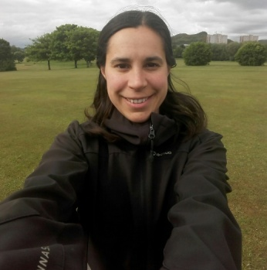
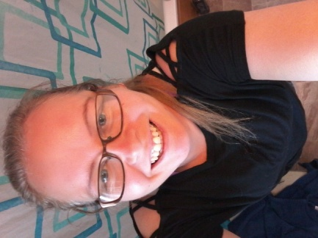
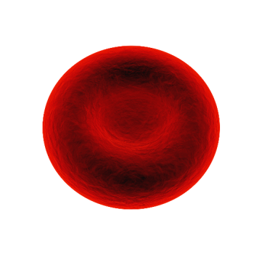
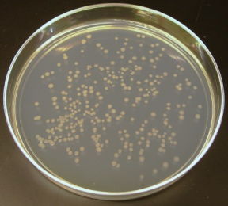
Meet our Scientists
Cuiken Primary School is working with the Easter Bush Science Outreach Centre as part of the Great Science Share for Schools. We have lots of plans that your teacher will share with you. One of these is to give you the opportunity to ask some local scientists a question, they will answer your question and we will share this with you online in a special video. All of our scientists work at the University of Edinburgh’s Easter Bush Campus, but they all have very different jobs.
Read each of the scientist profiles and think of at least one question you would like to ask, you can ask more than one scientist the same question!
Name: Judit
Job title: Research Assistant
Organisation: Roslin Institute
Hi, my name is Judit and I am from Barcelona
in Spain, but I have been living in Edinburgh for
the past 7 years.
When I was a kid, I was curious about
everything. When I left school, I studied environmental science because I love nature.
I love traveling, hiking and camping with friends and my energetic dog!
I work in a lab to find proteins. Proteins are present in all living things like, plants, animals, bacteria or viruses. Proteins have many important functions in the body.
Name: Lindsay
Job title: Lab Technician
Organisation: Easter Bush Campus
Hi, I’m Lindsay and I have worked here for five
years in three different buildings, with lots of
friendly people.
I have an eight year old cat called Woody. He
was a rescue cat.
I really enjoy keeping active and during lockdown I’ve been taking walks and joining in with the Joe Wicks PE classes. I also really enjoy reading.
My main job is to prepare the microbiology classes for our students. Microbiology is the study of microorganisms like bacteria. I also help out with handling real-dogs at the vet school - working with dogs is so fun it doesn’t even feel like work!
This is a red blood cell, its job is to carry oxygen around your body. It is full of a protein called haemoglobin (heem-a-globe-in) that sticks to oxygen, and helps the red blood cell to take it to every part of the body.
This is bacteria growing on a jelly-like substance called agar. We need to make sure that the agar is sterile so that we only grow the type of bacteria we need.
Now send your question to your teacher, watch out for it being answered on Tuesday 23rd June!
This work by University of Edinburgh is licensed under a CC BY-NC-ND Creative Commons Attribution 4.0 International License.
Notes:
Piglet picture https://pixabay.com/photos/piglet-sleep-pig-farm-relaxed-3386356/free for commercial use, not attribution required.
Agar plate https://commons.wikimedia.org/wiki/File:Ecoli_colonies.png pubic domain

